Slide 1
SOA Project Review-2
BATCH - 5
ONLINE QUIZ SYSTEM
Team Members: 1.OM PANDEY 2420030791 2.SRUJAN 2420030082 3.DHANUSH 2420030788 4.MUNUDEEP 2420090018
Under the Guidance of
Dr.NAVYATHA RANI,
Department of Computer Science and Engineering,
KLH CSE Bowrampet Campus

Slide 2
Problem Statement
PROBLEM STATEMENT
Traditional quiz systems rely on manual question paper preparation, distribution, evaluation, and result generation, making the overall process time-consuming and prone to errors. Managing users, questions, quizzes, and results through separate manual processes is also difficult and inefficient. Therefore, there is a need for a centralized and automated online platform that can conduct quizzes, automatically evaluate student answers, and generate results quickly. To address these limitations, the proposed Online Quiz System uses a microservices-oriented architecture to improve scalability, maintainability, and reliability.

Slide 3
Objectives
OBJECTIVES
To develop a user-friendly web-based Online Quiz System** that enables secure student participation and allows administrators/instructors to manage quizzes, users, questions, and results.
*To provide an effective quiz platform** with multiple-choice questions, correct answers, marks, and time limits.
To automatically evaluate submitted answers** and quickly generate and display quiz scores and results.
To implement a microservices-oriented architecture** to improve the system’s scalability, flexibility, and maintainability.

Slide 4
Online Quiz System
PROJECT DESIGN :-
The system is designed as a web-based, microservices-oriented application that automates the complete online quiz process.
Main design components:
User Interface — Students/Admins interact with the system.
Authentication Service — Handles user login and authentication.
Quiz Service — Manages quiz creation and quiz details.
Question Service — Manages quiz questions and answers.
Evaluation Service — Evaluates submitted answers.
Result Service — Generates and manages quiz results.
Database — Stores users, quizzes, questions, answers and results.
REST APIs — Enable communication between application components.

Slide 5
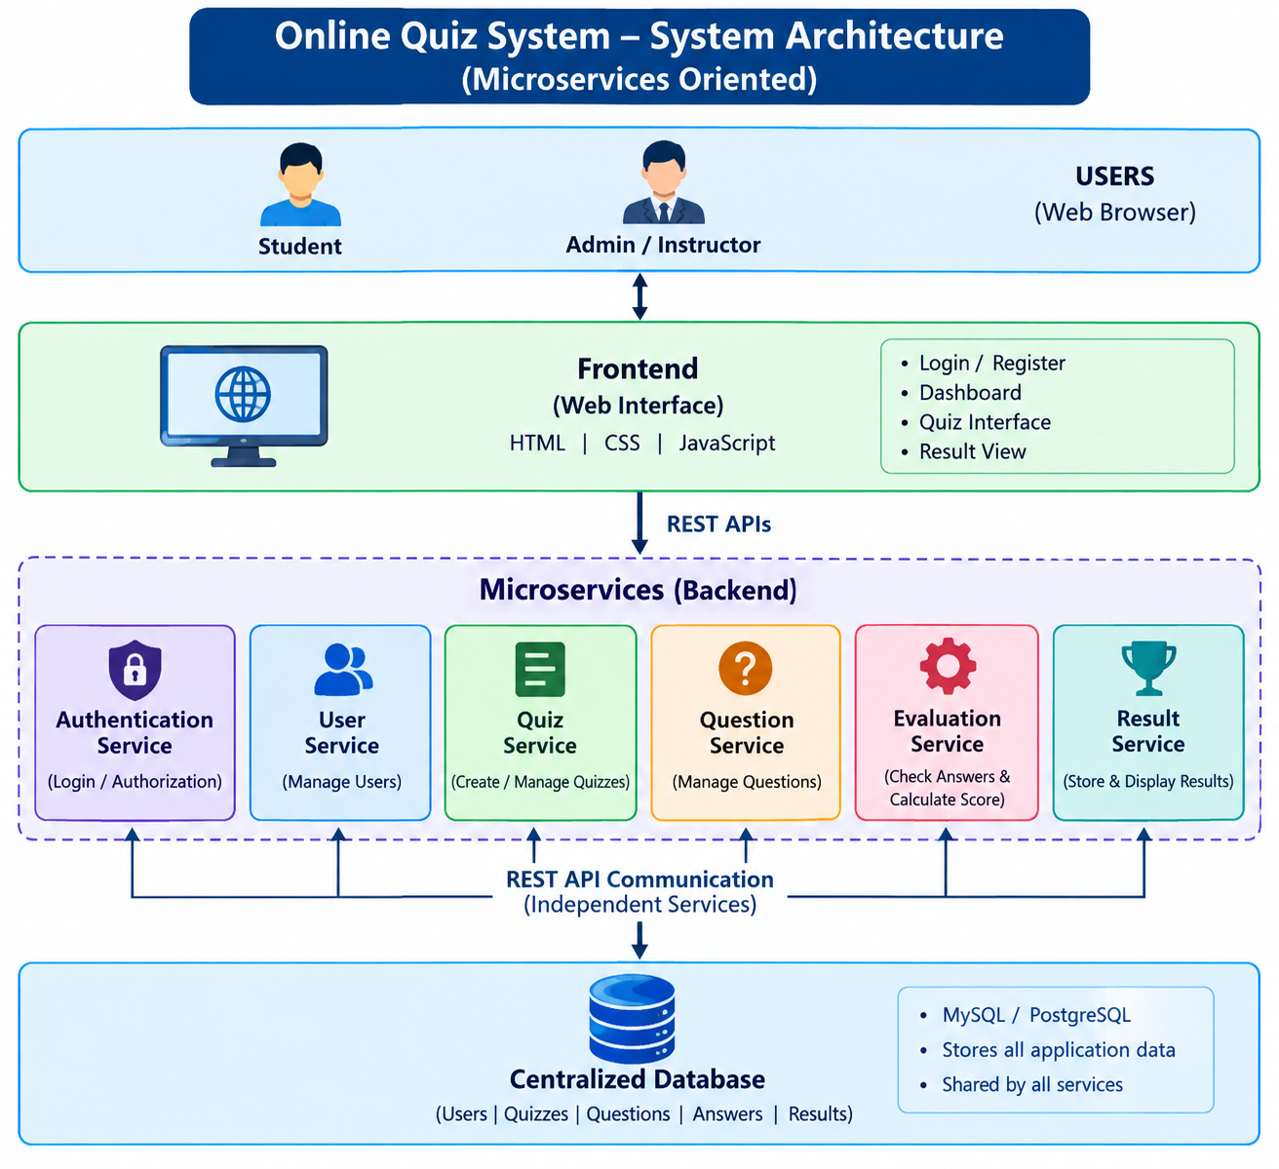
System Architecture :-

Slide 6
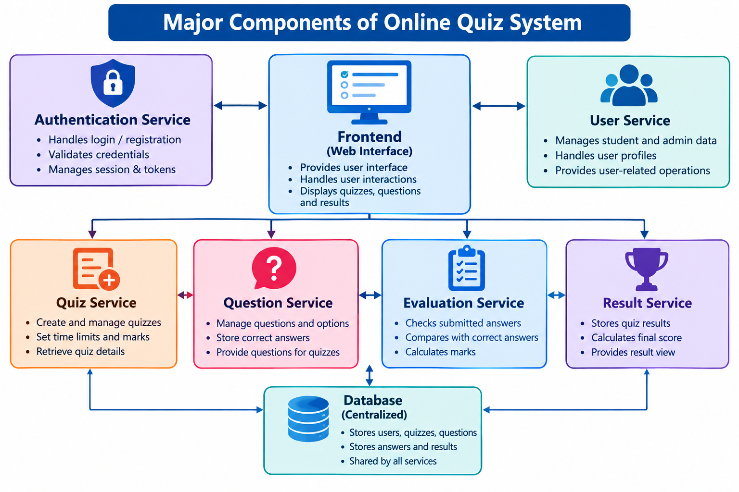
Major Components

Slide 7
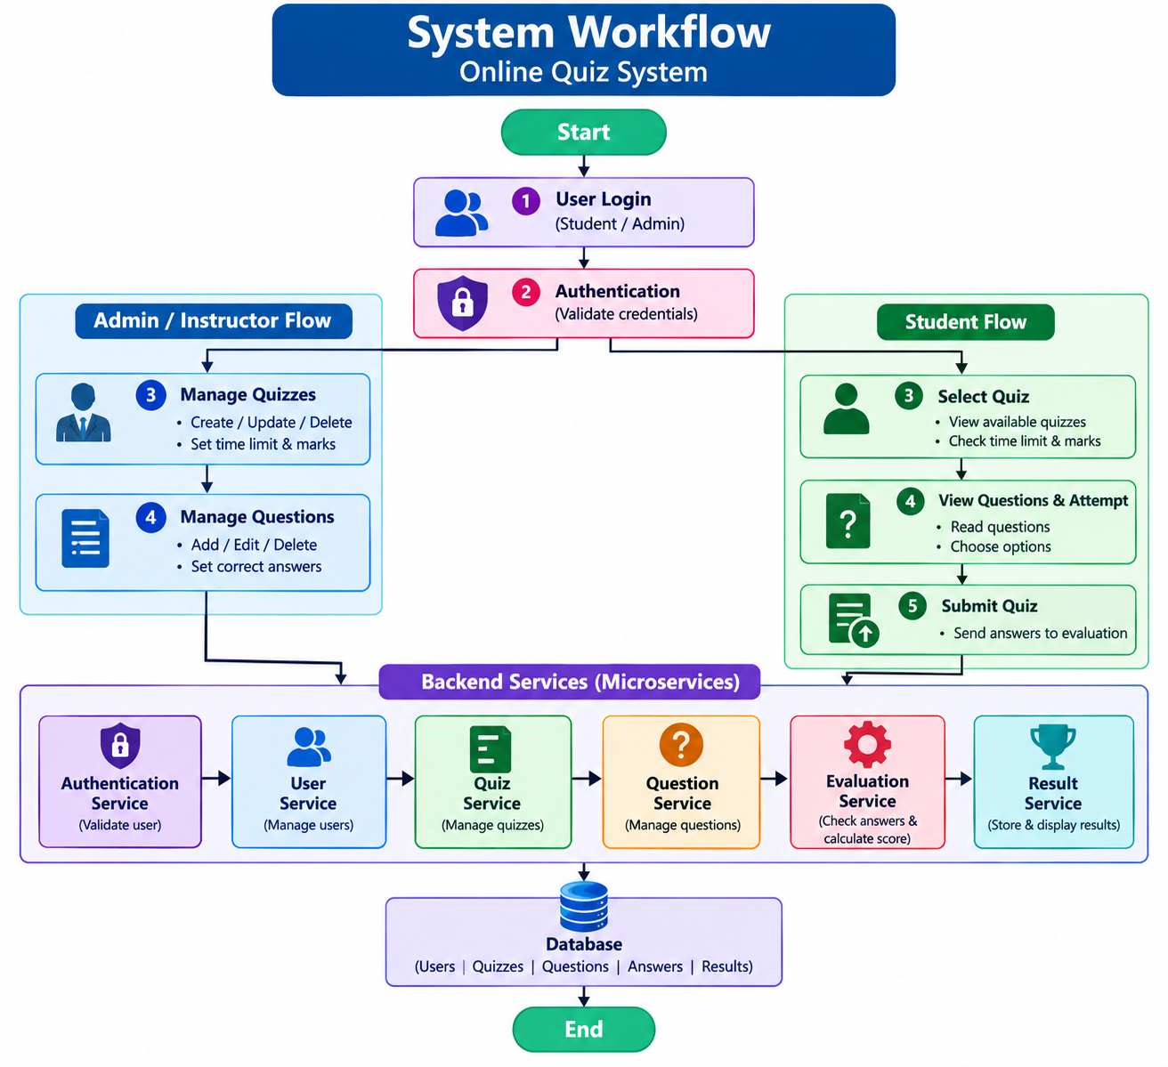
System Workflow :-

Slide 8
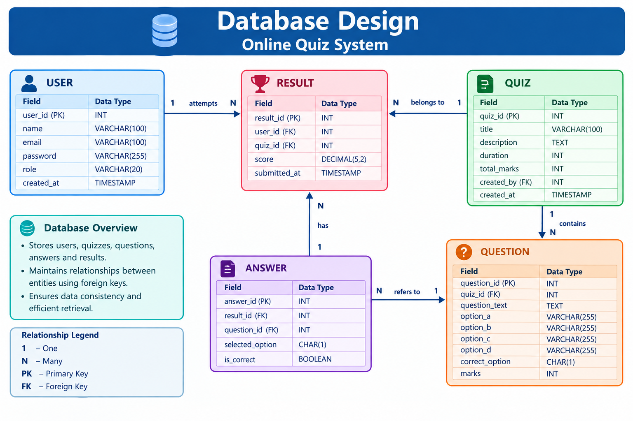
Database Design :-

Slide 9
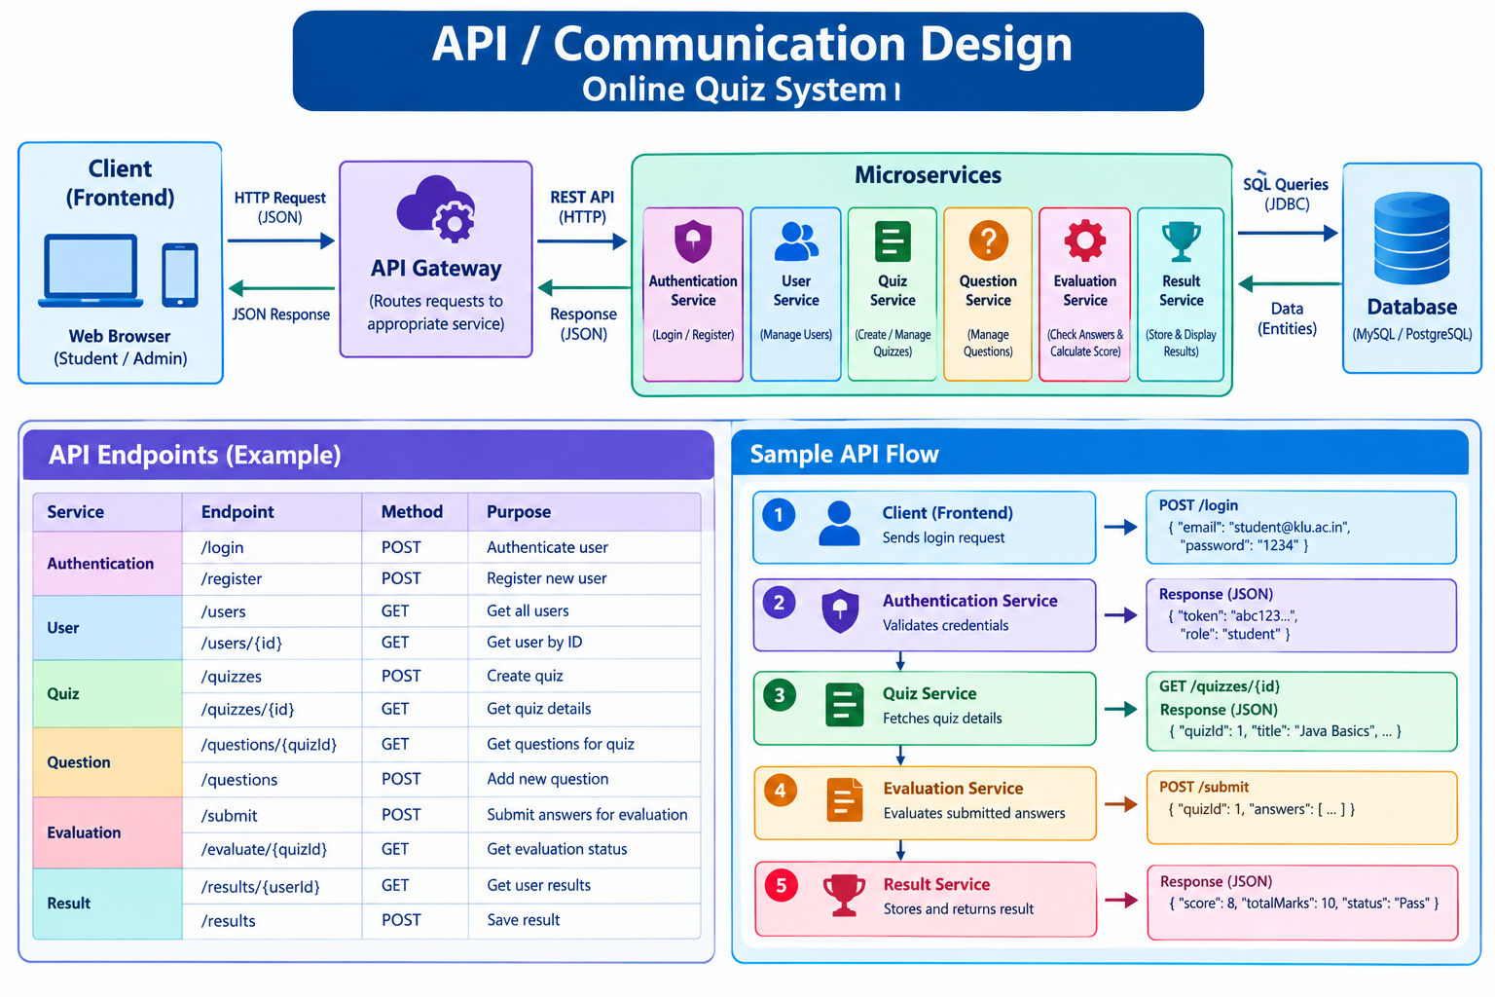
API / Communication Design:-

Slide 10
METHODOLOGY ADOPTED:-
Requirement Analysis
↓
System & Architecture Design
↓
Database Design
↓
Microservices Development
↓
Frontend Development
↓
API Integration & Testing
↓
System Testing
↓
Deployment & Documentation

Slide 11
. MICROSERVICES DEVELOPMENT
Service Main Function
Authentication Login / authentication
User User management
Quiz Quiz management
Question Question management
Evaluation Answer evaluation
Result Result generation

Slide 12
Requirement Analysis
Functional Requirements :-
User registration and login
Quiz creation and management
Question management
Quiz participation
Answer submission
Automatic evaluation
Score calculation
Result generation
Non-Functional Requirements:-
Maintainability
Scalability
Reliability
Security
User-friendly interface

Slide 13
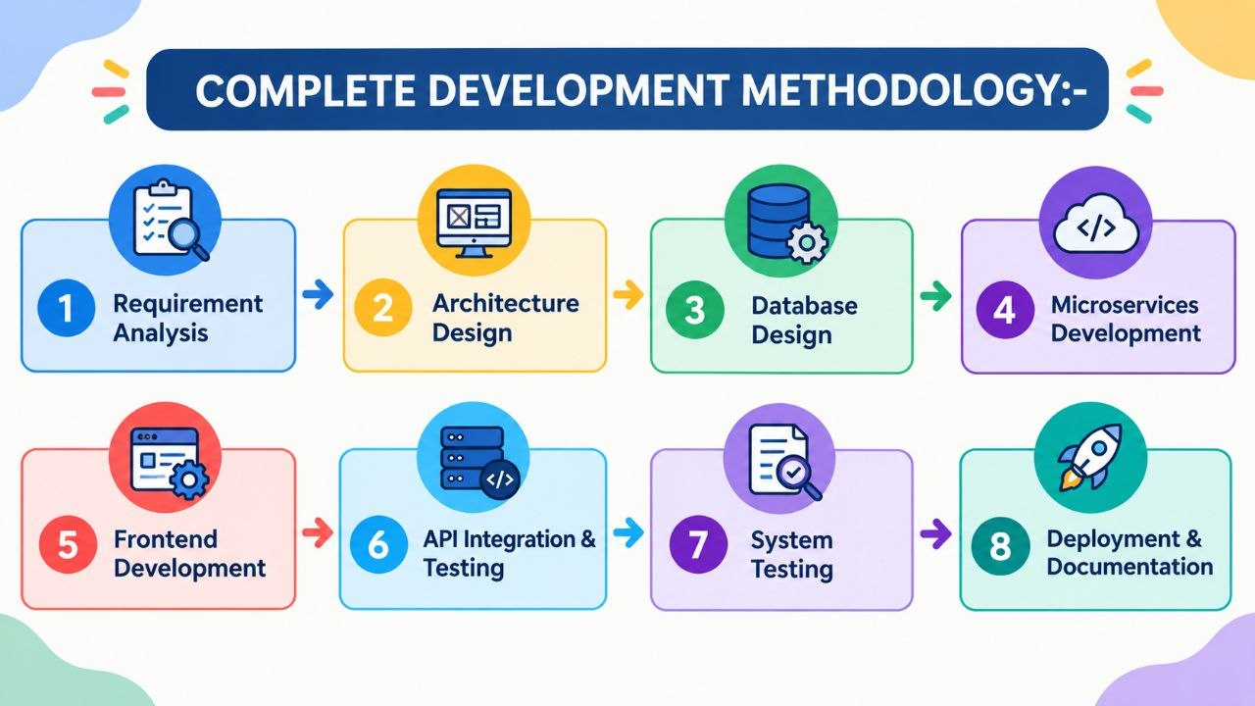
COMPLETE DEVELOPMENT METHODOLOGY:-

Slide 14
TECHNICAL SOUNDNESS OF THE PROJECT:-
TECHNOLOGY STACK:-
Layer Technology
Frontend Web-based User Interface
Backend Microservices
Communication REST APIs
Database Centralized Database
Development Modern Web Technologies
Testing API & System Testing

